Slide 1
Diffusion Models for Images & Videos

Slide 2
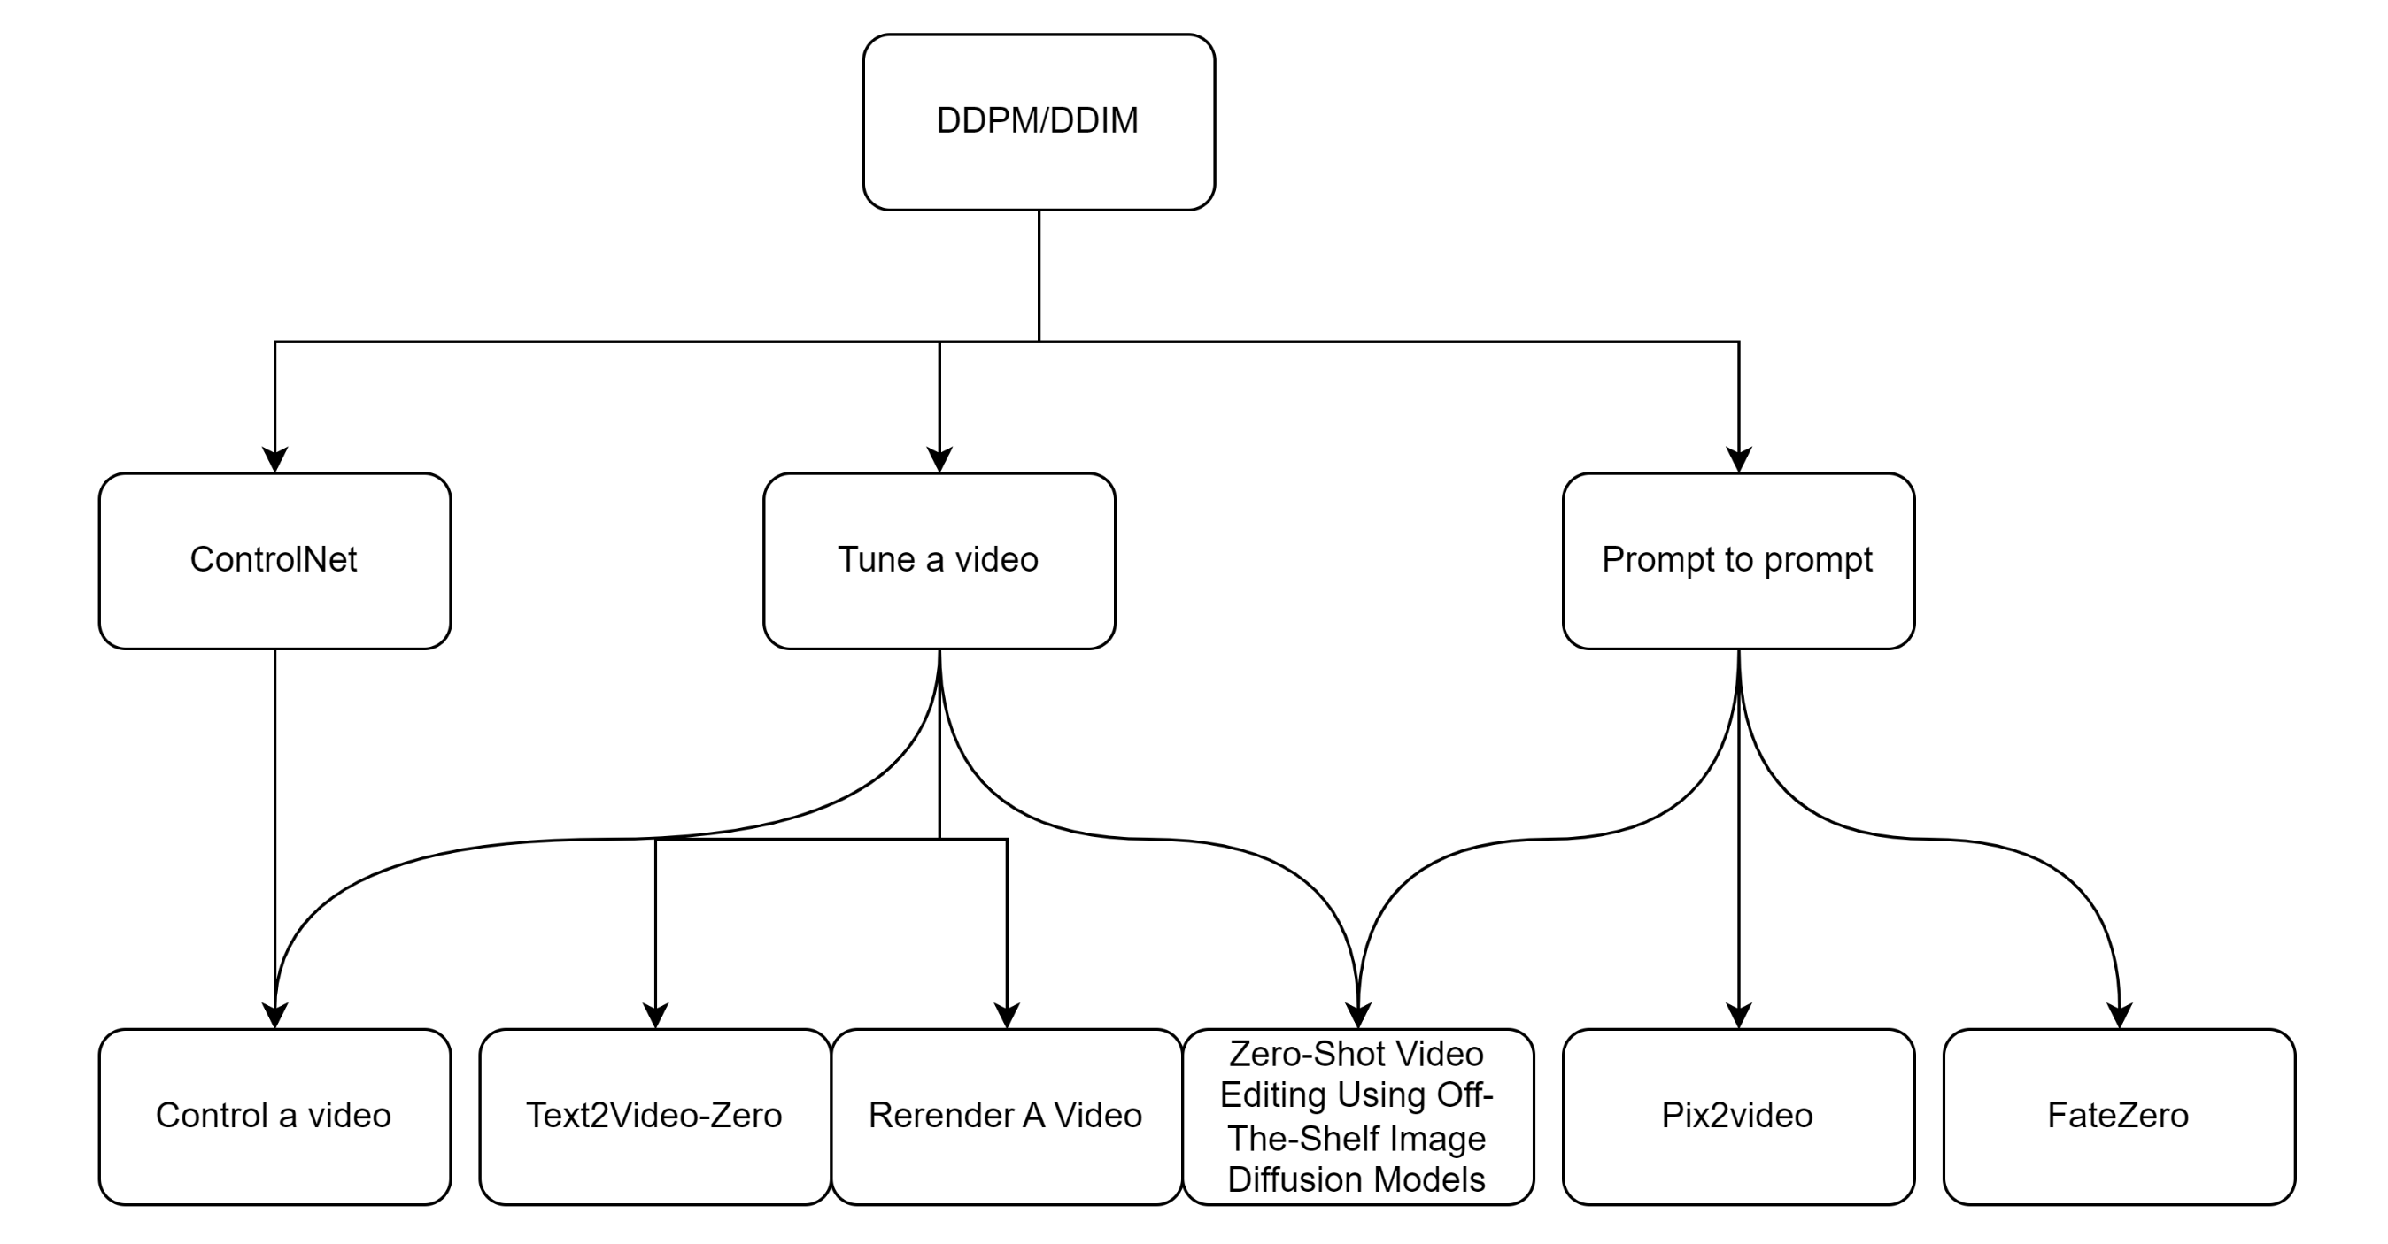

Slide 3
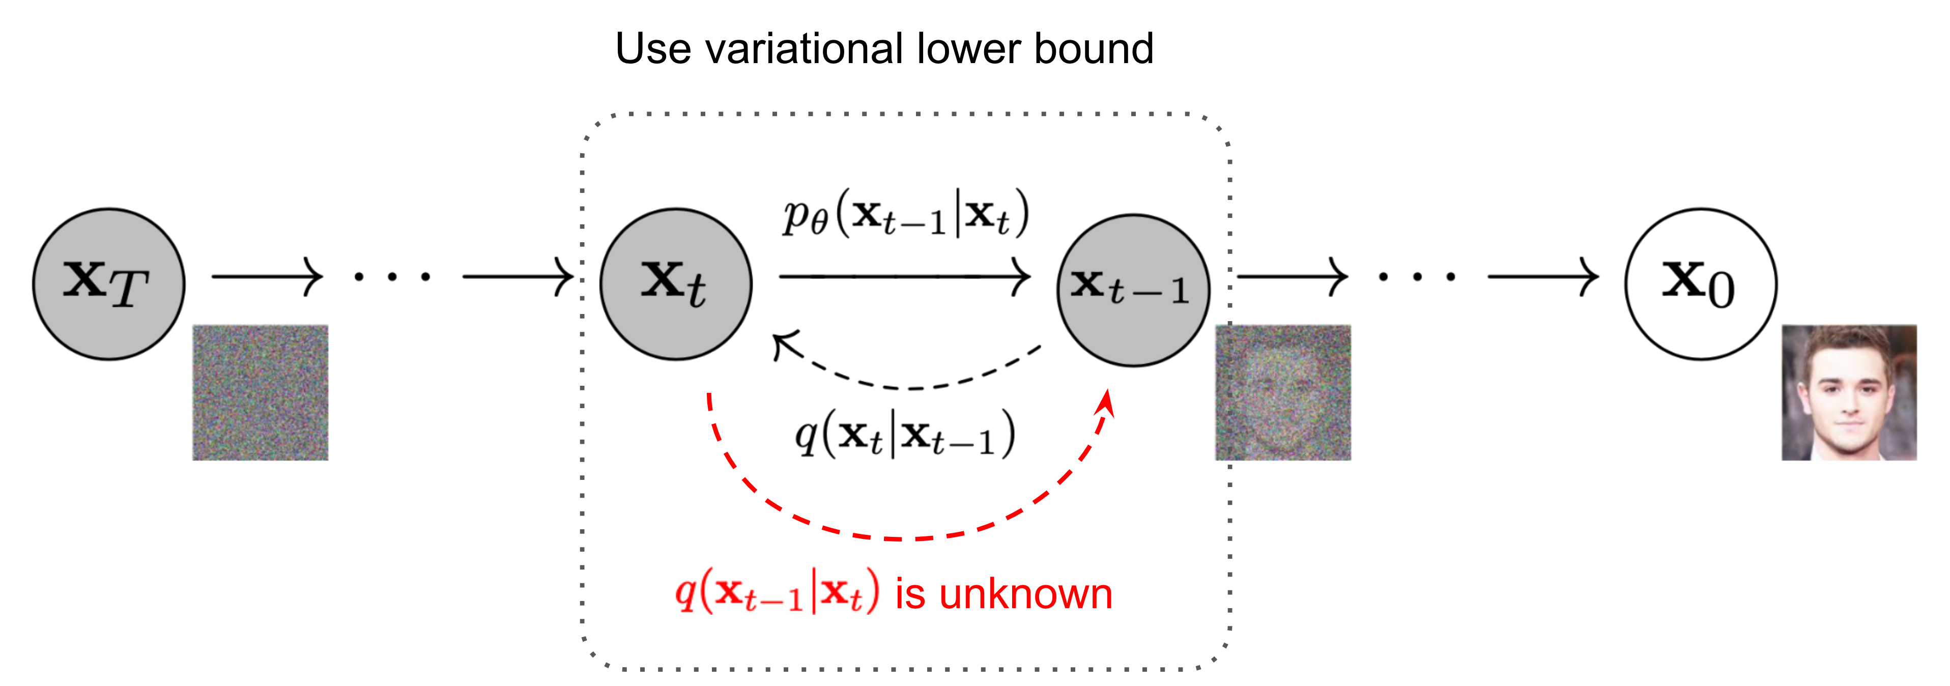
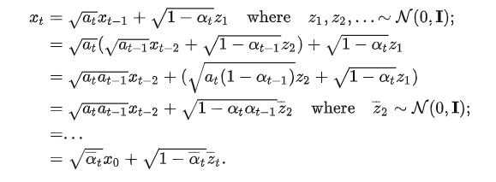
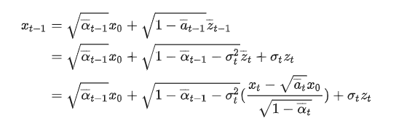


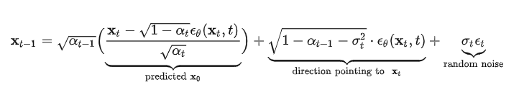
DDPM/DDIM
DDPM:
DDIM:
Sampling:
Inversion:

Slide 4
DDPM/DDIM

Slide 5
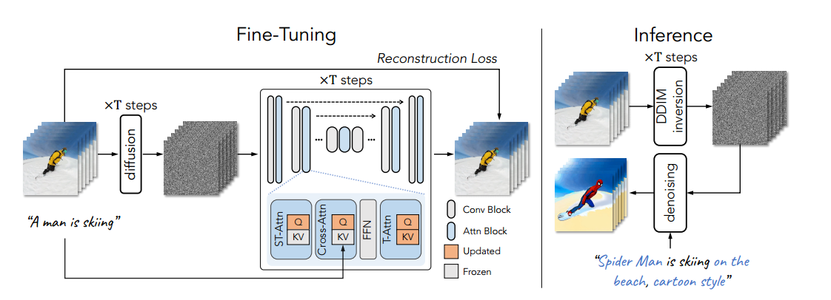
Tune a video

Slide 6
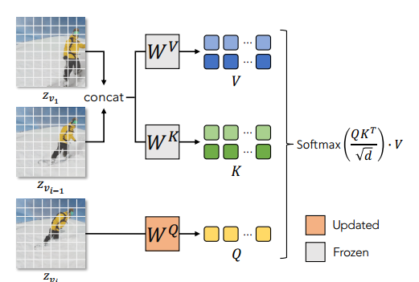
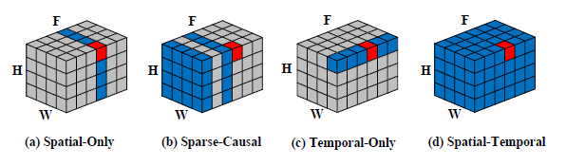

Tune a video
Regarding motion : T2I models are able to generate images that align well with the text, including the verb terms.
Regarding consistent objects : Simply extending the spatial self-attention in the T2I model from one image to multiple images produces consistent content across frames

Slide 7
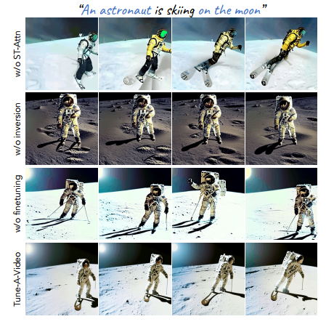
ST-Attn : 维持前后景的一致性
Inversion : 维持输入视频的动作
Finetuning :优化运动的流畅程度
Notes:
消融实验

Slide 8
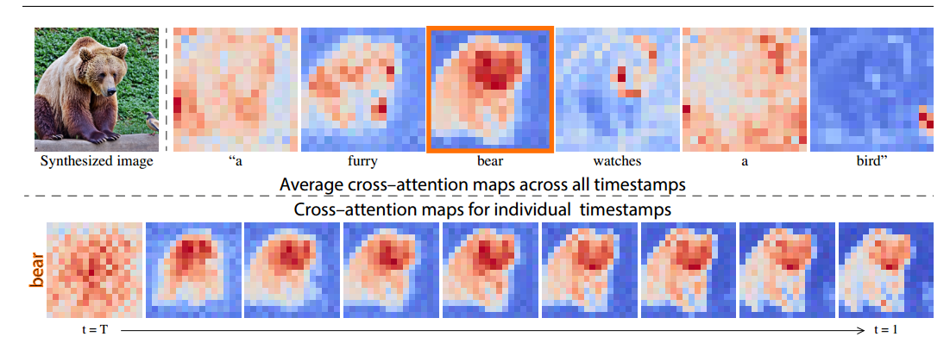
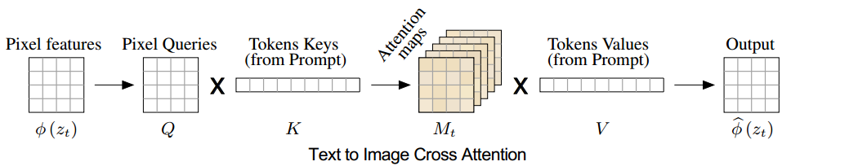
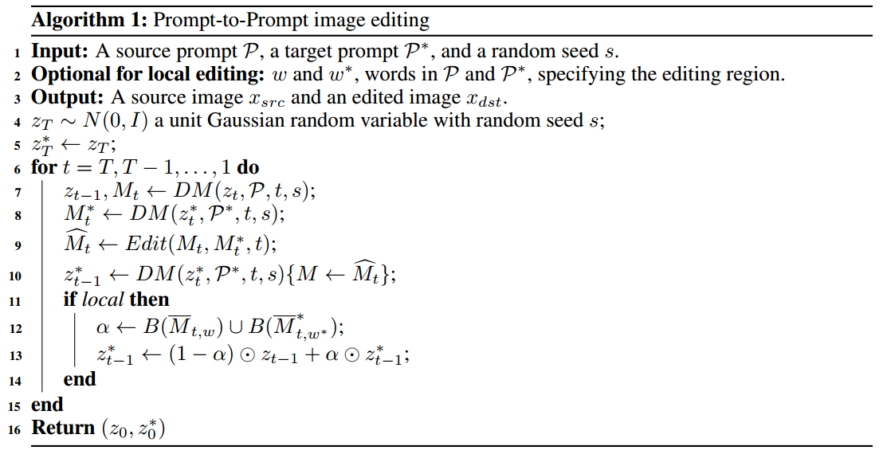



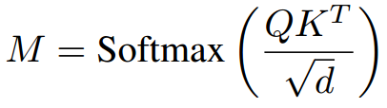

Prompt to prompt

Slide 9
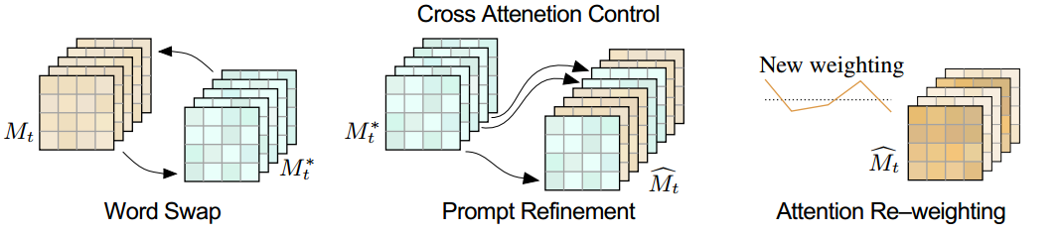



Prompt to prompt
Word Swap
Prompt Refinement
Attention Re-weighting

Slide 10
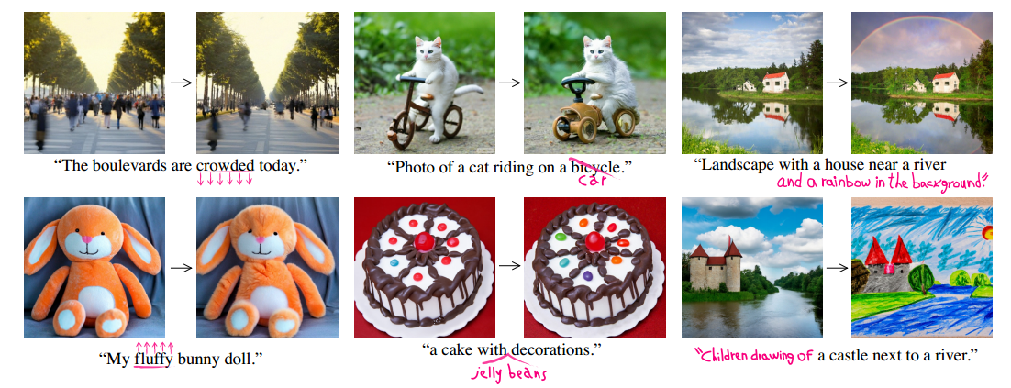
Prompt to prompt

Slide 11
Zero-Shot Video Editing

Slide 12
Zero-Shot Video Editing

Slide 13
Zero-Shot Video Editing

Slide 14
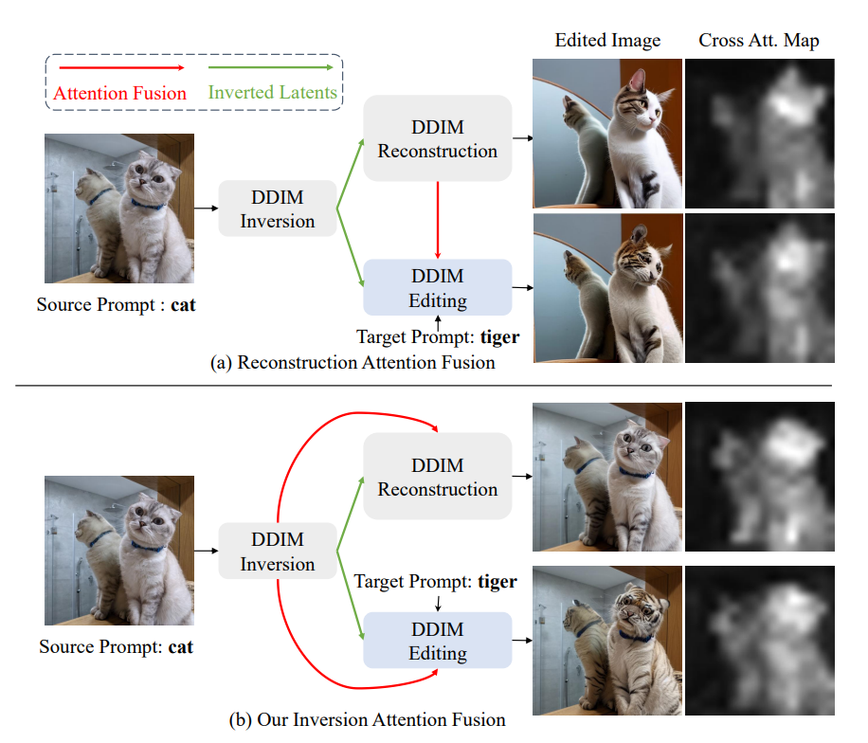
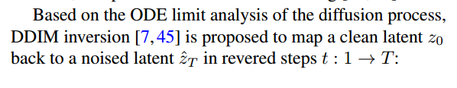

FateZero
DDIM Sampling:
DDIM Inversion:

Slide 15
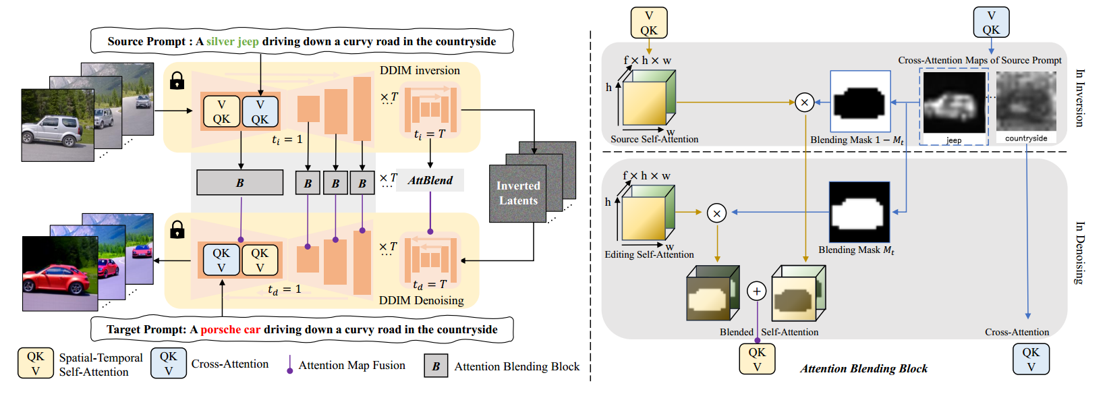

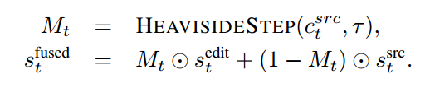

FateZero

Slide 16
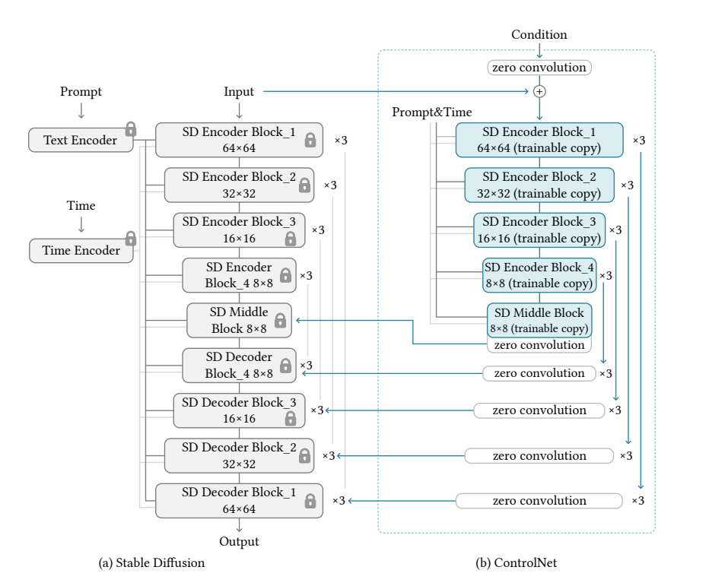
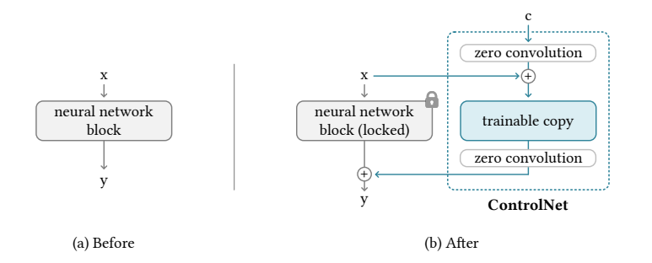

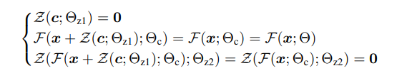
ControlNet
First step

Slide 17
Control a video

Slide 18
Control a video

Slide 19
Text2video-zero

Slide 20
Rerender a video

Slide 21
Pixel2video

